Slide 1
EXCEPTIONS
JAVA

Slide 2
EXCEPTION HANDLING
Program correctness guarantees correct results for all valid input.
BUT what happens when the input is invalid?
An important criterion of program reliability is the robustness
measures how well the program runs under various conditions
If a program crashes too easily when a wrong type of argument is passed to a method or an invalid input value is entered, we cannot say the program is very robust.
A mechanism called exception handling can be used to improve the program’s robustness.

Slide 3
Catching Exceptions
The exception-handling mechanism can be viewed as another form of control structure.
An exception represents an error condition that can occur during the normal course of program execution.
When an exception occurs, the normal sequence of flow is terminated and the exception-handling routine is executed.
When an exception occurs, we say an exception is thrown.
When the matching exception-handling code is executed, we say the thrown exception is caught.
By using exception-handling routines in our code, we can increase its robustness.

Slide 4
An example
Let’s begin with a short program to illustrate the exception-handling mechanism.
define a service class that supports a method to input a person’s age.
Using this service class, we can write a program that gets a person’s age and replies with the year in which the person was born.
Notice the program takes into consideration whether the person already had a birthday this year.

Slide 5
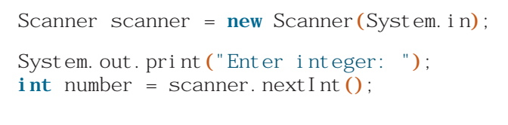
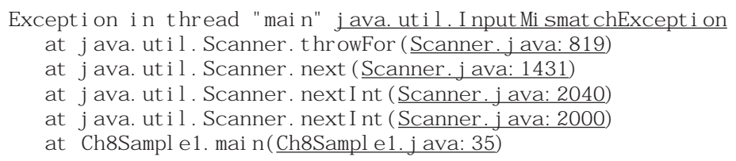
Catching Exceptions
Consider the code:
What would happen if we entered, say, abc123, an input value that is not an int?

Slide 6
Catching Exceptions
This error message indicates the system has caught an exception called the InputMismatchException, an error that occurs when we try to convert a string that cannot be converted to a numerical value.
Up until now, we have let the system handle the thrown exceptions.
However, when we let the system handle the exceptions, a single thrown exception most likely will result in erroneous results or a program termination.
Instead of depending on the system for exception handling, we can increase the program’s reliability and robustness if we catch the exceptions ourselves by including error recovery routines in our program.

Slide 7
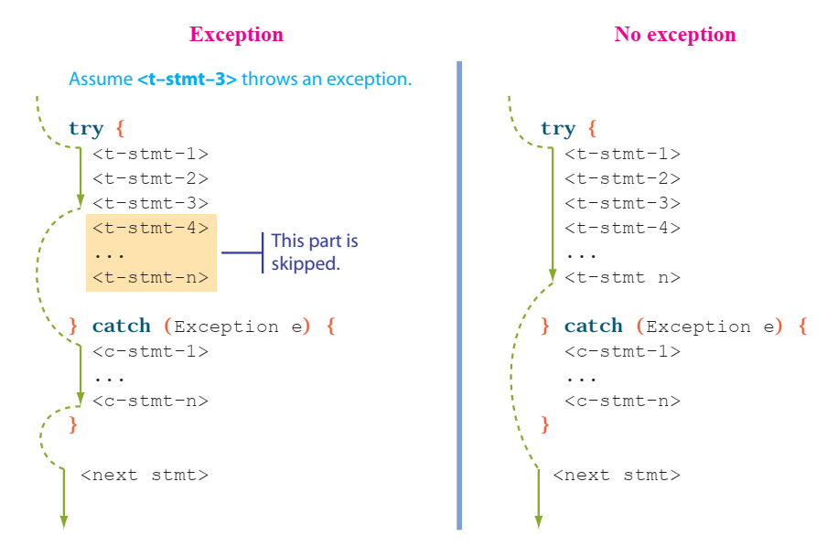
Two possible control flows of the try-catch statement
Assume <t-stmt-3> throws an exception

Slide 8
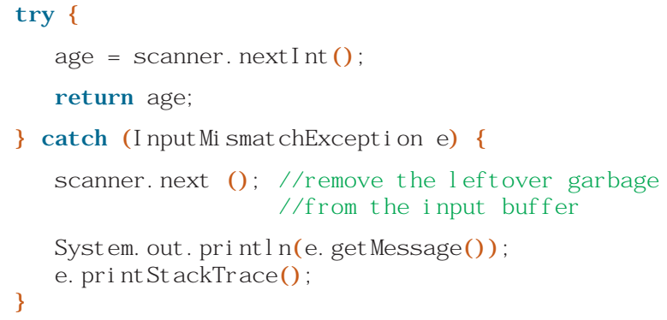
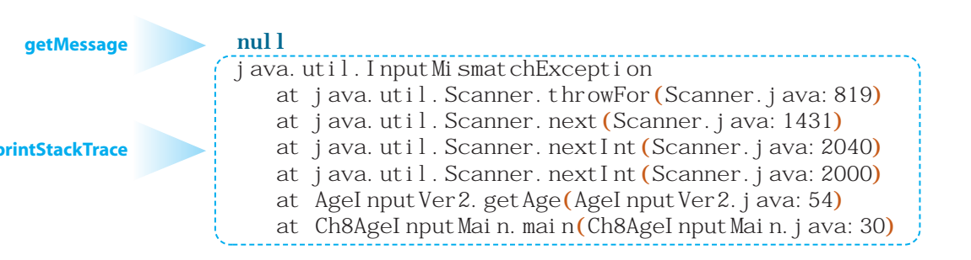
Info. About Thrown Exceptions
There are two methods to get some information about the thrown exception:
getMessage and printStackTrace. We can call these methods inside the catch block as follows:
With this modified code, if we enter ten as an input, then we will receive the following output:
Notice that the result we see from the printStackTrace method is the one we saw when the system handled the thrown exception (AgeInput class). The stack trace shows the sequence of calls made from the main method of the main class to the method that throws the exception.

Slide 9
Multiple CATCH blocks
Our current implementation accepts invalid negative integers. Since negative age is not possible, let’s improve the code by disallowing the input of negative integers.
When there are multiple catch blocks in a try-catch statement, they are checked in sequence
because the exception classes form an inheritance hierarchy, it is important to check the more specialized exception classes before the more general exception classes.

Slide 10
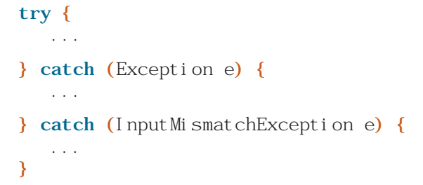
Multiple CATCH blocks
because the exception classes form an inheritance hierarchy, it is important to check the more specialized exception classes before the more general exception classes.
the second catch block will never be executed
because any exception object that is an instance of Exception or its subclasses will match the first catch block.
When an exception is thrown, a matching catch block is executed and all other catch blocks are ignored.

Slide 11
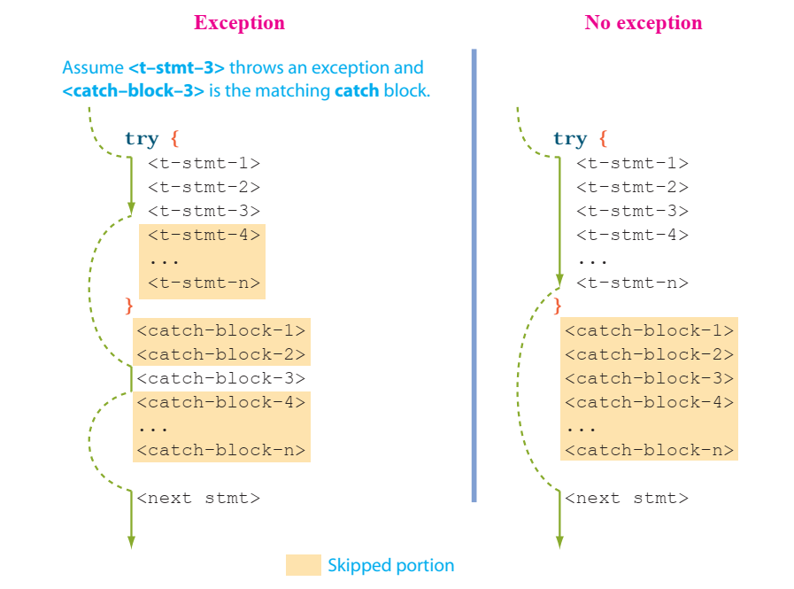
Multiple CATCH blocks

Slide 12
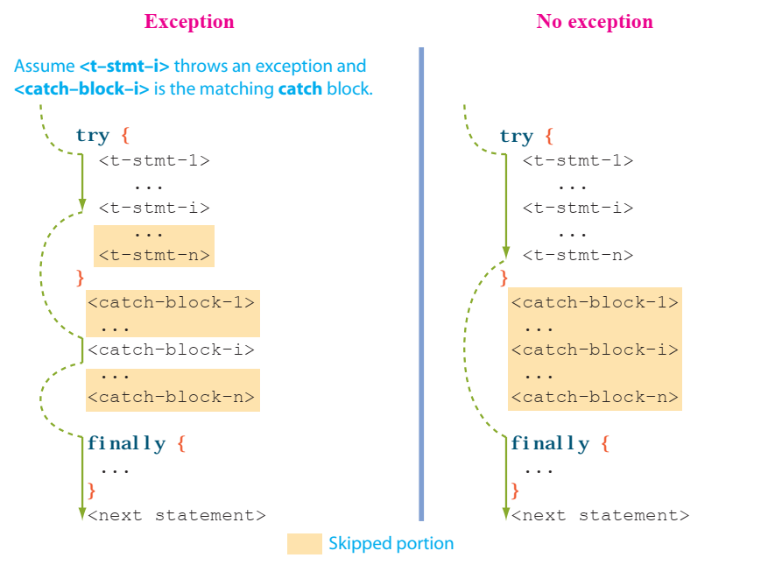
Finally block → ALWAYS EXECUTED!

